Slide 1
The Economic Consequences of Conflict
Patrick Imam
IMF Resident Representative
July 2019
The views expressed do not necessarily reflect the views of the IMF or the Executive Board of the IMF.
Notes:
Today, we will be presenting our work on the economic consequences of conflict in sub-Saharan Africa that is part of the recent sub-Saharan Africa (SSA) Regional Economic Outlook.

Slide 2
Context
Notes:
What was the motivation to look at the economic consequences of conflict in SSA?

Slide 3
Sub-Saharan Africa remains prone to conflict
Sub-Saharan Africa: Geographical Distribution of Conflict-Related Deaths as a Share of Population
Notes:
SSA has been marred by conflicts during the past several decades, with more than a million verified conflict-related deaths since 1989 and a further 18 million displaced persons originating from the region.
And while the intensity and distribution of conflicts have varied over time, the region remains prone to conflict even today.

Slide 4
Uptick in conflict in recent years
Selected Regions: Share of Countries in Conflict
Number of Countries in Conflict
Sources: Uppsala GED and IMF Staff Calculations
Notes:
In fact, SSA is one of the most conflict prone regions in the world, with only the MENA region having slightly higher incidence of conflict.
In the 1990s, about 35 percent of countries in the region were affected by conflict.
And while there was a decline in the number of countries in conflict in the region in the first decade of the new millennium, we have seen an uptick in the number of conflict afflicted countries in recent years.
Note: A country is defined to be in conflict in a given year if it had at least 25 conflict-related deaths.

Slide 5
What do we do?
Explore the economic consequences of conflicts in SSA:
    Trends in conflict
    Impact of conflict on macroeconomic growth
    Channels through which conflict affects growth
    Localized and spillover effects of conflict using nightlights data
    Fiscal implications of conflict
Notes:
Given this background, in our work we focus on five questions:
How have the prevalence and intensity of conflict evolved over time?
What is the impact of conflict on economic growth and what factors determine the size of the impact?
What are the key channels through which conflict affects economic growth?
Are the effects of conflict only felt locally in the area where conflicts occur, or do they have substantial spillover effects as well?
What are the fiscal implications of conflict?
Our sample comprises the 45 sub-Saharan African countries covering the last three decades.

Slide 6
Stylized Facts
Notes:
Looking at some stylized facts regarding conflicts in the region…

Slide 7
Increase in conflict intensity, though still below the 1990s
Total Conflict-Related Deaths
Sub-Saharan Africa: Countries in High-Intensity Conflict
Sources: Uppsala GED and IMF Staff Calculations
Notes:
It is apparent that conflicts in SSA have been particularly deadly.
While the exact number of conflict-related deaths is difficult to ascertain, estimates suggest that in the 1990s alone, verified conflict-related deaths in the SSA region totaled at least 825,000 (over two-thirds of global conflict deaths). The high death toll was driven by the genocide against the Tutsi in Rwanda; the Ethiopian-Eritrean war; and protracted violence in Angola, the DRC, Liberia, and Sierra Leone.
The number of conflict-related deaths in the region fell sharply in the 2000s as many of these conflicts ended. A resurgence in violence in recent years, however, implies an increase in conflict-related deaths, which have averaged about 14,000 a year since 2014 (compared to only 2,200 in 2010).
We use the number of conflict-related deaths in relation to total population as a measure of conflict intensity (right panel). In the 1990s, eight SSA countries, on average, were in the top quartile of the world distribution of conflict intensity. By 2010 there was no SSA country in the top quartile, but since 2013 about four countries have (on average) experienced intense conflict that places them in the top quartile (including CAR, DRC, South Sudan, and several Sahel countries).

Slide 8
Partly driven by an increase in violence in the Sahel region
Sahel Region: Conflict-Related Deaths
Distribution of Deaths in Sahel Region, 2011-17
Sources: Uppsala GED and IMF Staff Calculations
Notes:
Although the overall prevalence of conflict in the 2000s has declined compared with the 1990s, the Sahel region has experienced a significant increase in violence since 2010.
Across the Sahel countries, the Lake Chad Basin (where Nigeria, Cameroon, Chad, and Niger share a border) has seen a particularly significant increase in violence, with the number of deaths in the region accounting for 77‍ percent of all conflict-related deaths in the Sahel, and about 40 percent of all conflict-related deaths in sub-Saharan Africa, over 2010–17.

Slide 9
Overall conflict prevalence has declined…
Sub-Saharan Africa: Share of Conflict Countries by Geographic Region and Economic Classification
Economic Classification
Geographic Regions
Sources: Uppsala GED and IMF Staff Calculations
Notes:
Across the region, there has been some change in the geographic distribution of conflicts over time. Southern Africa has become relatively peaceful since the turn of the century, but conflict remains widespread elsewhere. Central Africa remains the most prone to conflict followed by East Africa.
Among the different types of countries (resource-intensive and non-resource-intensive countries), conflict continues to be more prevalent among oil exporters and least prevalent among non-resource-intensive countries.

Slide 10
… and the nature of conflicts seems to have changed
Sub-Saharan Africa: Share of Deaths in Different Types of Conflicts
Terrorist Incidents
Sources: Uppsala GED and IMF Staff Calculations
Notes:
While it is often difficult to clearly distinguish between different types of conflict, our data does seem to point towards a change in the nature of conflicts in the region.
Large-scale, state-based conflicts largely drove developments in conflict-related deaths in SSA during the pre-2000 period (such as those in Angola, Eritrea, Ethiopia, and Sierra Leone).
Since then, however, the share of non-state-based conflict deaths—involving nongovernmental armed groups and terrorist attacks targeting civilians—has increased significantly.
The number of terrorist incidents has increased not just in the Sahel region, but elsewhere as well, with the Democratic Republic of the Congo, Kenya, and Nigeria affected the most.

Slide 11
Conflicts in SSA are highly persistent
Average duration of conflict in the region is about 4 years, with some countries involved in conflict for the entire sample period, 1989-2017
However, conflict persistence has generally declined, except for in the Sahel region where conflicts have become more persistent
Conflict Exit Probabilities
Sources: Uppsala GED and IMF Staff Calculations
Notes:
Conflict in sub-Saharan Africa also tends to be persistent, although there is considerable variation in the duration of conflicts across the region.
The persistence of conflicts has generally declined over time, except in the Sahel region. For SSA as a whole, the probability of a country exiting conflict has increased from 20 percent in the pre-2000 period to about 24 percent afterward.

Slide 12
Conflicts have resulted in large number of displaced people
Persons of Concern from Sub-Saharan Africa
Destination of Sub-Saharan African Refugees
Source: UNHCR.
Notes:
There has also been a significant increase in the number of (United Nations-recognized) persons of concern from sub-Saharan African countries.
The number of internally displaced persons, asylum seekers, and refugees has more than tripled, rising from fewer than 5 million in the 1980s to 18 million in 2017.
Notably, as of 2017, the majority of the close to 7 million refugees and asylum seekers who originated in sub-Saharan Africa had resettled within the region. Refugees constituted more than 3 percent of the population of Chad and Uganda in 2017 (only Jordan, Lebanon, and Turkey, following the Syrian crisis, have a higher refugee-to-population ratio).
Similarly, the number of internally displaced people in the region is five times higher—rising from fewer than 2 million to 10 million over the past two decades.

Slide 13
Impact on Growth
Notes:
So what are the overall economic implications of these conflicts? To answer this question we apply different methodologies, approaching the question from different angles. These include (i) standard growth regressions, where we look at the direct effect of conflict, non-linear effects, and do several robustness checks; (ii) local projection methods to get at dynamic effects; and (iii) counterfactual analysis using 11 clearly identified conflict episodes in SSA.

Slide 14
How do conflicts affect economic growth?
Conflict Episodes: Growth Rates and Cumulative GDP per capita Losses
Average Growth Rate by Country Type
Source: IMF staff calculations.
Notes:
But before getting into formal econometric analysis, it would be instructive to look at a simple unconditional comparison of economic growth rates in conflict vs. non-conflict cases, which suggests that real GDP growth is, on average, about 2.5 percentage points lower where there is conflict.
Growth tends to be lower in conflict cases across all country groups, but commodity exporters (especially, non-oil commodity exporters) have suffered the most. This reflects in part the intense conflicts in many of these countries (Central African Republic, Democratic Republic of the Congo, Liberia, and Sierra Leone).
When focusing on 11 conflict episodes where the onset of intense conflict episodes can be clearly identified (right chart), the conflict’s effect on growth is, in general, seen to be most pronounced in the first year of the conflict, after which it gradually declines. However, as growth rates remain negative on average over an extended period of time, the cumulative effect on output increases, with real GDP per capita being 12 percent lower five years after the onset of the conflict.

Slide 15
Growth Regressions
Emerging and Developing Countries: Impact on Growth of Increase in Conflict Intensity
Sub-Saharan Africa: Effect on Growth of Different Conflict Intensity Levels
Source: IMF staff calculations.
Notes:
These results are confirmed by more rigorous empirical analysis, which—while controlling for other standard determinants of growth—shows that conflicts have a significantly negative effect on economic growth in SSA.
An increase in the conflict-intensity measure from no conflict to the top quartile of conflict (29 conflict-related deaths per million people) is, on average, associated with a reduction in real GDP per capita growth of 3.2 percentage points a year.
Furthermore, the effects on growth appear to be non-linear (right panel). Conflicts in the bottom two quartiles of the conflict intensity distribution (which constitute less than 5 conflict-related deaths per million people), on average, do not have a statistically strong effect on growth. However, being in the top two quartiles of conflict intensity can lower growth by 2 to 4 percentage points.

Slide 16
Domestic factors matter
Impact of Conflict on Growth, Role of Institutions and Fiscal Fundamentals
Increase in conflict intensity in countries with strong institutions has a smaller effect on growth than in those with relatively weak institutions.
Countries with strong fiscal fundamentals (lower deficits or debt) also experience a smaller adverse effect of conflict on growth
Conflicts in economically important locations have a larger effect on growth than those in the periphery
Source: IMF staff calculations.
Notes:
Furthermore, the effect of conflicts on growth also appears to be conditional on some macroeconomic characteristics—notably, institutional quality and fiscal fundamentals—at the onset of the conflict.
Specifically, an increase in conflict intensity is associated with about 1.5 percentage points lower growth in countries with relatively strong institutions (defined as falling in the top quartile of the distribution of the Institutional Quality Index) compared with 3 percentage points where institutions are weaker (in the bottom quartile of the distribution).
Similarly, countries with weaker fiscal fundamentals, in terms of higher deficits or debt, experience a larger decline in growth, presumably because there is less room to respond to the destruction caused by conflict. In particular, a country with a negligible fiscal deficit experiences a growth decline of 2.4 percentage points as conflict breaks out relative to a decline of 3.4 percentage points for a country with a fiscal deficit of 5 percent of GDP.

Slide 17
Effect of conflicts are persistent
Impulse Response of per-capita GDP in response to Shock to Conflict Intensity
Effect lasts at least five years after conflict onset
Onset of intensive conflict lowers output by 5 percent in the first year, with the cumulative effect over 5 years reaching 7.5 percent
Source: IMF staff calculations.
Notes:
Moreover, the effects of conflicts are dynamic, lasting at least five years after the onset of the conflict.
Tracing out dynamic effects using the local projection method, the onset of a high-intensity conflict (29 conflict-related deaths per million or 75th percentile of the distribution) is estimated to lower growth by 5 percent in the first year, with the cumulative effect reaching about 7.5 percent after five years and remaining statistically significant.

Slide 18
Output loss in the long term
Output loss based on pre-conflict projections
Output loss based on synthetic control method
SSA: Index of Real GDP per-capita, Actual versus Forecast (Median value among conflict episodes)
SSA: Index of Real GDP per-capita, Actual versus Synthetic Control (Median value among conflict episodes)
Source: IMF staff calculations.
Notes:
Finally, we try and estimate permanent output losses from conflict based on 11 conflict episodes. These episodes represent major conflict events which occurred after a period of relative peace marking a clear uptick in conflict
We use two methods to estimate permanent output losses
First, we compare the actual evolution of per-capita GDP in these episodes to the projection made before the start of the conflict. As the left panel shows, per-capita GDP on average fell by over 8 percent, compared to a forecast of a 7 percent rise, suggesting that output was over 15 percent below its potential level 5 years after the start of the conflict.
We also estimate permanent output loses using the synthetic control method. This involves creating a control group for each conflict episode where the control group is simply a weighted average of non-conflict countries which resembles the conflict countries characteristics before the start of violence.
As the right panel shows, this method finds that 5 years into the conflict, output is over 20 percent below where is could have been in the absence of conflict.

Slide 19
Channels

Slide 20
Key Channels of transmission
Investment
Trade (exports)
Productivity
Human capital
Notes:
What are some of the key channels through which conflicts tend to have such large and persistent effects?

Slide 21
Economic and social disruption
Impact of Conflict on Investment, Exports, and Productivity
Impact of Conflict on Primary Enrollment
Impact of Conflict on Maternal Deaths
Source: IMF staff calculations.
Notes:
Investment, trade, and productivity are all affected significantly by conflict.
Increasing conflict intensity from no conflict to the top quartile is associated with lower real investment growth of 4.5 percentage points, driven partly by a decline in private sector credit growth.
Conflicts also reduce export and productivity growth by 5.5 and 1.3 percentage points, respectively.
Importantly, conflicts also destroy human capital, which may take years to re-develop.
On average, primary school enrollment rates for girls and boys are almost 13 and 9 percentage points lower, respectively, in intense-conflict cases than in non-conflict cases. Life expectancy is significantly lower during conflicts, partly due to direct conflict-related deaths. However, other health indicators such as maternal mortality also deteriorate.

Slide 22
Spatial impact through night-light data

Slide 23
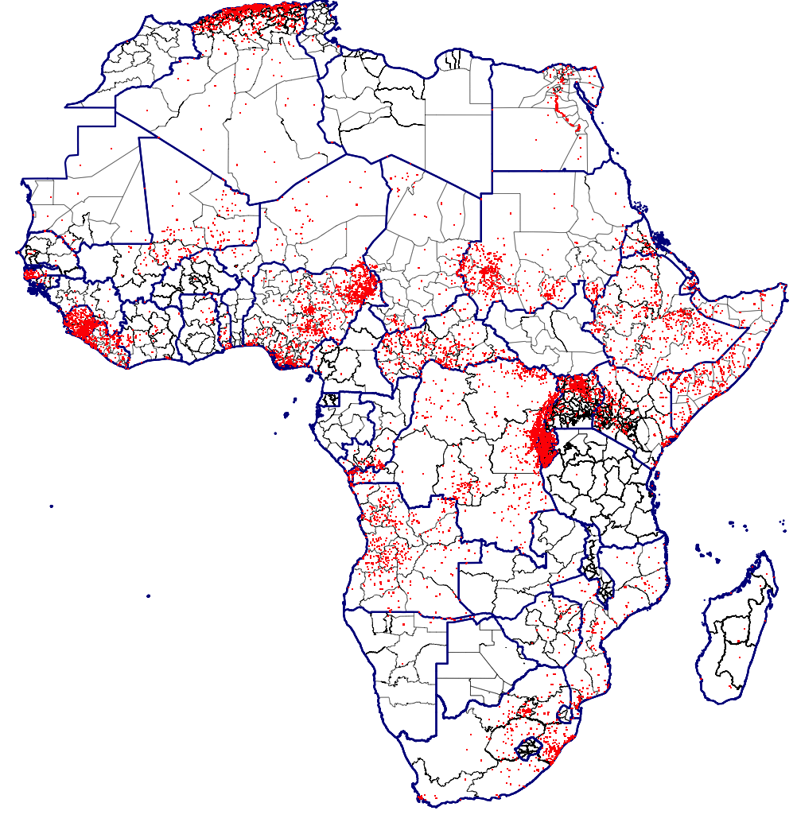
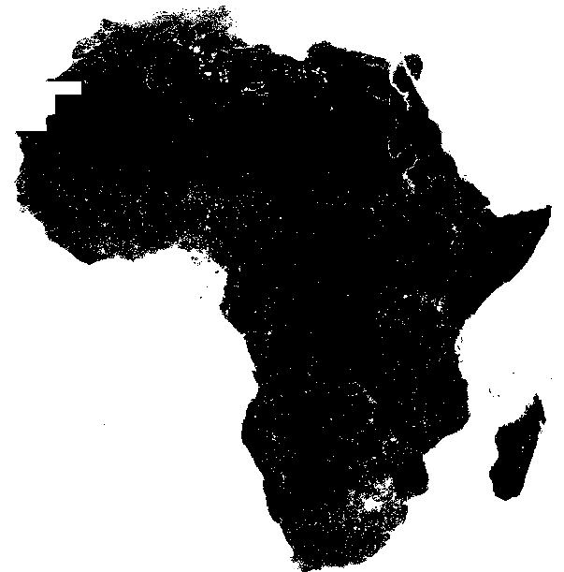
Conflict and Nightlights Data
Red dots are conflict events between 1989-2017
Locate conflicts at state/province level
Confine night lights to states/provinces
Use “sum” of night lights as proxy for real GDP
Notes:
Conflicts in SSA are often localized and concentrated in particular regions within a country—in fact, conditional on a country being in conflict, on average only 40 percent of states within the country experience conflict-related deaths.
Thus, the impact of conflicts is unlikely to be uniform across the country. However, lack of data availability on economic activity at a spatially disaggregated level makes it difficult to investigate the impact of conflict at the local level, or its potential spillover effects to nearby regions within (or across) countries.
We use satellite based night lights data (from National Oceanic and Atmospheric Administration) to construct proxy for local economic activity.

Slide 24
Nigeria: Conflict and night-light activity
Panel A: Change in Number of Conflict-Related Deaths, 2008-10 vs 2011-2013
Panel B: Change in Night-Lights Growth, 2008-10 vs 2011-2013
Source: IMF staff calculations.
Notes:
Using these data, it is apparent that economic activity in northeast Nigeria, for example, declined after 2010, when the Boko Haram insurgency became more violent.

Slide 25
Direct and Spillover Effects of Conflict
Sub-Saharan Africa
Source: IMF staff calculations.
Note: Impact of 100 deaths at state level on growth using night lights; direct and spillover effects.
Notes:
Econometric analysis confirms that there is a statistically and economically strong adverse effect of conflict on night-light growth at the state level. Conflicts that result in 100 fatalities (around the median of the distribution of conflict-related deaths at the state level) are associated with about 6.5 percent lower real GDP growth at the state level.
In addition to the direct effect of conflict in sub-Saharan Africa, there is also evidence of significant spillover effects of conflict to neighboring states, though the effect declines with the distance of the neighbor. Specifically, 100 fatalities in neighboring states within 500 kilometers (“Spillover 1” in chart) are associated with about a 2 percentage point reduction in growth; the effect is statistically insignificant for more distant states (“Spillover 2”).

Slide 26
Fiscal Implications
Notes:
Conflicts can also have substantial effects on the public finances of a country…

Slide 27
Fiscal balance deteriorates in conflicts
Impact on Fiscal Variables of Intensive Conflict
Revenue: decreases because of disruption in economic activity, loss of tax base, and lower tax efficiency.
Expenditure: shift in composition away from capital spending to military expenditure.
Fiscal balance: average deterioration of about 2 percent of GDP
While public debt rises by about 9 ppts.
Source: IMF staff calculations.
Notes:
…affecting both the revenue and expenditure sides.
On the revenue side, conflicts can reduce collections by disrupting economic activity, destroying part of the tax base, and potentially lowering the efficiency of tax administration. There is evidence of these channels being potentially important for sub-Saharan Africa, where an increase in conflict intensity is associated with a decline in total revenue of about 12 percent in real terms or about 2 percent as a share of GDP.
On the expenditure side, an increase in conflict intensity is associated with, on average, 9 percent higher real budgetary military spending (or about 0.6 percent of GDP), while real capital expenditures decrease by about 9 percent. Total public spending, therefore, does not increase significantly during conflicts. This suggests that security concerns lead to a shift in spending from growth-friendly capital expenditures to military spending.
Moreover, the net effect of an increase in conflict intensity is thus an increase in the fiscal deficit of about 1.7 percent of GDP, while debt to GDP ratio increases by about 9 ppts on average.

Slide 28
Zimbabwe and Conflicts
Zimbabwe has experienced low intensity conflict marked by periods of escalation and political violence.
    After independence in 1980, Robert Mugabe’s political party, the Zimbabwe African National Union-Patriotic Front (ZANU-PF), entrenched control over state institutions and the economy.
    The contest between ZANU-PF and the Movement for Democratic Change, post 1999, has led to violence and political tensions. As a result, political landscape continues to be characterized by mistrust and attempts to eliminate challenges to power.
    Land reform brought another element of conflict
Conflict today remains rooted in disputes over national power, economic hardship and pre-colonial disputes which have not been resolved.
Notes:
After independence in 1980, Robert Mugabe’s political party, the Zimbabwe African National Union-Patriotic Front (ZANU-PF), entrenched control over state institutions and the economy.
The contest between ZANU-PF and the Movement for Democratic Change, post 1999, has maintained violence and political landscape continues to be characterized by mistrust and attempts to eliminate challenges to power.
Zimbabwe continues to face problems relating to corruption, human rights violations, and a stagnant economy. Economic hardships have worsened, heightening social tensions, resulting in protests – the January 2019 protests.
There was some peace during the GNU.

Slide 29
Key Channels of transmission in Zimbabwe
Investment
Productivity
Human capital
Trade (exports)
Notes:
What are some of the key channels through which conflicts tend to have such large and persistent effects?

Slide 30
Conclusions

Slide 31
Key Takeaways
Conflicts have increased in SSA since 2013 after a decline through the 2000s
Conflicts impose significant economic costs:
  The impact on growth is large, persistent, and non-linear
  Stems through a decline in investment, trade and productivity, and destruction of physical and human capital
  Significant spillover effects on nearby regions
  Negative fiscal implications
Notes:
To summarize some of the key results of our research:
There has been a worrying uptick in conflict prevalence and intensity in SSA since 2013 after a decline through the 2000s
Conflicts impose significant economic costs:
The impact on growth is large and persistent, and increasing in the intensity of conflicts
This is largely driven by a decline in investment, trade and productivity, and destruction of physical and human capital
Conflicts also have significant spillover effects on nearby regions, though the effect is smaller than that on the country involved in conflict.
Conflicts also have negative fiscal implications—on average, lowering revenue while raising military expenditures and shifting resources away from much-needed social and developmental spending. This further accentuates the debilitating consequences of conflicts.

Slide 32
Policy implications
Imperative to prevent conflicts.
Mitigate the adverse consequences of conflicts through limiting the loss of human and physical capital, and trying to maintain well-functioning institutions.
Well-targeted and coordinated humanitarian aid and concessional external assistance to both the countries involved in conflict and those facing spillover effects can provide relief and create room to respond.
Notes:
Given the large humanitarian and economic costs associated with conflicts, it is imperative to prevent conflicts. The causes of conflict are often complex, encompassing a host of economic, social and political factors. Low income levels, poor growth outcomes, weak state capacity, and inequality of opportunity—especially across ethnic, religious, and regional groups—tend to be associated with a greater likelihood of conflict. These factors point to the need to build institutional capacity, promote inclusive growth, and foster social cohesion. Moreover, economic policy alone is unlikely to be enough, with the political process playing a pivotal role in conflict prevention.
Mitigating the Negative Effects: For countries in conflict, efforts should focus on limiting the loss of human and physical capital, including by protecting social and development spending. Maintaining well-functioning institutions and fiscal fundamentals can help to mitigate the adverse effects of conflicts by providing room for governments to respond.
Role of External Assistance: Well-targeted and coordinated humanitarian aid and concessional external assistance can create room to respond to the ravaging effects of conflict. External assistance may also be essential for countries suffering from the spillover effects of conflict to protect displaced populations and alleviate the strains generated in host countries.

