Slide 1
Curbing Corruption
Patrick Imam
International Monetary Fund
July, 2019
The views expressed do not necessarily reflect the views of the IMF or the Executive Board of the IMF.

Slide 2
GENERAL OBSERVATIONS

Slide 3
Corruption in Zimbabwe
Corruption in the public sector (TI director declared that US$5m is lost every day to corruption)
Diamond (In 2018, Robert Mugabe declared that US$15 billion in diamond-related revenue is unaccounted for)
Indigenization bills (≠nationalization): gave government the right to seize a controlling 51% stake in foreign and white-owned businesses
A dozen anti-corruption laws introduced over the past 15 years, often with support from donors, with no tangible results.
In 2000, a promotional lottery organized by the Zimbabwe Banking Corporation, announced that Robert Mugabe won the Z$100,000 first prize jackpot.

Slide 4
Diagnostics of the problem exist: 2018 Auditor General’s Report – Some findings
As of May 31 2019, 76 SOEs and parastatals out of a total of 179 entities had not yet submitted their financial statements for audit by Government
Zimbabwe Electrification Transmission and Distribution Company (ZETDC) —has not yet taken delivery of transformers nine years after making a US$4,9 million payment
GMB made an advance payment of $1 million in 2016 for goods and services that were never delivered
Air Zimbabwe could not account for expenditures of about $14 million. Could not provide supporting documentation for operating expenses amounting to $13 million and $654 587 petty cash expenditure. The airline had an unexplained suspense balance of $27 million and could not account for all aircraft

Slide 5
Corruption Perceptions Index - TI
Notes:
Since its inception in 1995, the Corruption Perceptions Index, Transparency International’s flagship research product, has become the leading global indicator of public sector corruption.
The index offers an annual snapshot of the relative degree of corruption by ranking countries and territories from all over the globe.
The 2018 CPI draws on 13 surveys and expert assessments to measure public sector corruption in 180 countries and territories, giving each a score from zero (highly corrupt) to 100 (very clean).
Zimbabwe has improved from 21 in 2015 to a consistent 22 in 2016, 17 and 18. Regional pears Rwanda, Mauritius and South Africa are doing well.

Slide 6
How Zimbabwe is dealing with corruption
New Public Entitles Corporate Governance Act
The Act provides for the corporate governance of public entities and aims to improve the management structures of parastatals and other public entities.
An Anti Corruption Unit in the Office of the President – so far prosecutions by the Anti Corruption Commission are politically motivated – victims have been opposition factions and rivalry factions in the ruling ZANU PF
The Revenue Authority has a hotline for tip offs and is assisted by huge accounting firms e.g. Deloitte and Touche.
TA from the IMF has assisted ZIMRA specifically the customs area.
In terms of PFM, what we see is a lack of following procedures but the precolonial British systems that Zimbabwe inherited has assisted in minimizing funds abuse in Ministries.

Slide 7
Governance in the SMP – a Structural Benchmark
The IMF will field a diagnostic governance assessment mission in July 2019 and September/October 2019.
This assessment is designed to assist the government in developing and publishing Zimbabwe’s assessment and action plan to address governance vulnerabilities by end-December 2019 as agreed in the Staff Monitored Program (SMP), approved by IMF management in May 2019.
Focus will be mainly on the rule of law, anti-corruption institutions and polices, AML-CFT, fiscal governance issues, RBZ’s management of government bank accounts, and quasi-fiscal activities.

Slide 8
IMF work on Fiscal Governance
Transparency
Code and manual; recent work on natural resources industries
Fiscal Transparency Evaluations
Governance on public Investment
PIMA
Capacity building
Tax Administration
TADAT; RA-FIT; RA-GAP
Cooperation with other agencies
PEFA
OECD, World Bank…
Notes:
Over the years, the International Monetary Fund has built up comprehensive diagnostics on the quality of fiscal institutions. These tools have been part of the IMF’s capacity-building work across its membership. They help strengthen core institutional processes, promote integrity in public administration, and promote fiscal transparency. This work has been undertaken in cooperation with other international institutions (for example, the World Bank) and donors.
Fiscal Transparency Evaluations (FTEs) assess fiscal transparency practices against the principles outlined in the Fiscal Transparency Code with a focus on four pillars: (1) fiscal reporting; (2) fiscal forecasting and budgeting; (3) fiscal risk analysis and management; and (4) resource revenue management for specific needs of resource-rich countries. As of February 2019, 25 FTEs were publicly available.
Public Investment Management Assessments (PIMAs) help countries evaluate the strength of their public investment management practices. They evaluate 15 institutions that shape public investment decision-making at three key investment stages – planning, allocation, and implementation. As of February 2019, 51 countries had completed a PIMA, providing a basis to set up a reform plan tailored to each country’s needs.
A similar suite of tools is available to assess the performance of tax and customs administrations. The Tax Administration Diagnostic Tool (TADAT) is designed to provide an objective assessment of the health of key components of a country’s system of tax administration. TADAT assessments identify relative strengths and weaknesses, which helps in setting and prioritizing reform agendas and facilitating external support for reforms. Other IMF diagnostic tools for revenue administration include the Revenue Administration Fiscal Information Tool (RA-FIT), which compiles a set of performance indicators, and the Revenue Administration–Gap Analysis Program (RA-GAP), which helps countries estimate the size of tax gaps for major taxes; it provides a better understanding of factors affecting the size of, and changes in, those gaps—in particular, those stemming from taxpayer noncompliance.
We also cooperate with other institutions. For example, another tool in public financial management include the long-established Public Expenditure and Financial Accountability assessment, which has covered many low-income countries.

Slide 9
“Discretion Plus Monopoly Minus Accountability equals Corruption”
Why is International approach in fighting corruption often not successful?
Focus in on change in national law and building institutions such as anti-corruption commission
Problem: Italy, despite same laws, North and South of Italy very different corruption levels

Slide 10
“Discretion Plus Monopoly Minus Accountability equals Corruption” (Con’t)
We ignore African history (Africa was not always corrupt) and do problematic comparison with present “successes” (e.g. Sweden), by trying to copy paste their initiatives
By missing the historical/socio-economic context, changing laws has little effect or backfires (“It’s our Turn to Eat”)
Ignoring coordination trap: “everyone does it” (corruption not viewed as wrong)
Being “clean” in a corrupt system is costly
Small efforts to reduce corruption will often not succeed: in fact, each effort will appear as a failure, and so strategy will appear an ineffective.

Slide 11
How do you break-out of Corruption Trap: Ideally, need “Big Push”
Big push requires the will at the top (Lee Kwan Yew, Park, Kagame) to break negative equilibrium, but also coordination of key agencies, such as:
Signaling is key (jail not only corrupt opponents, but also corrupt friends)
Increasing risk of punishment: e.g. strengthen incentive to inform on corrupt acts (e.g. design a penalty system which encourages one or the other part to break the deal—first to inform remains immune)
Reward whistle-blowers/Provides courts with good wages and right incentives and rewards
Creation of new, freestanding revenue authority (this is at the heard of a clean state)

Slide 12
“Big push” unlikely in practice in most countries: Must therefore address corruption leakages slowly and step by step

Slide 13
ADDRESSING CORRUPTION IN PUBLIC FINANCIAL ADMINISTRATION

Slide 14
Corruption
Definition: “The abuse of public office for private gain”
State capture vs. administrative corruption
Difficult to measure: Largely based on perceptions
Persistent and correlated with level of development
Sources: Worldwide Governance Indicators; IMF, WEO Database.
Notes:
What we mean by corruption? The abuse of public office for private gain.
These include administrative corruption, where corrupt acts take existing laws and regulations as given, as well as state capture, whereby public officials accept bribes in exchange for altering legislation or regulation to favor private firms or individuals.
How to measure? This is difficult—as, corruption tends to be hidden… In the last 3 decades we had several measures being developed based on surveys of perceptions. We will use as the main reference the Control of Corruption --part of the Worldwide Governance Indicators (developed by economists at the World Bank)--and which aggregates many of the individual indicators/surveys…
Based on the evidence, we observe that corruption tends to be persistent. However, there are exceptions, where some countries have been able to make large improvements in relatively short period—as shown in this picture.
Corruption is not only persistent, but also strongly correlated with income or level of development of countries. Nevertheless, we still find significant differences among advanced economies…

Slide 15
Corruption and Government
Revenues
Corruption enhances tax evasion
Tax laws
Tax administration
Undermines culture of tax compliance
Management of Natural Resources
Expenditures
Distorts budget decisions
Implementation of policies
Procurement/public investment
Wages and pensions
Extrabudgetary funds
State-owned enterprises
Notes:
The Monitor provides a discussion on the many channels how corruption affects the operations of governments. I want to just highlight some of hotspots.
These hotspots including on the revenue side:
Corruption facilitates tax evasion and could even lead to legislate tax laws that will create loopholes or other ways for some to escape paying taxes.
Another main area is on the exploration of natural resources, like oil and gas and mining. In many cases, secrecy around the contracts of exploration facilitate high degree of corruption.
On the spending side:
Perhaps the main hotspot for corruption is public procurement. This is especially the case related to public investment and defense spending…
Corruption in state-owned enterprises (SOEs) is another area of high risk of corruption. There are some high profile cases, like in Brazil or South Africa, but the reality is that this is widespread. A survey from OECD show that almost half of companies reported corrupt acts.

Slide 16
Fiscal Costs: Leakages in revenues across all income groups
More corruption, Less Government Revenues
Source: Worldwide Governance Indicators, World Economic Outlook, and staff estimates.
Note: average government revenues as share of GDP for countries with the lowest levels of corruption (top 25% of the control of corruption) and highest levels of corruption (bottom 25%) for each group. It excludes oil exporters
Note: IMF staff estimates based on cross-country and panel regressions. Shows the impact on government revenues when there is one standard deviation improvement in the control of corruption (WGI). *** statistically significant at 1%; ** significant at 5%.
Notes:
Let me now turn to the evidence on potential fiscal costs.
The chart in the left side shows a striking picture: it shows that the most corrupted governments collect on average 4 percent of GDP less in revenues compared to their peers. That is not an issue just among low income countries.
These differences are confirmed when we do econometric analysis, that is we analyze the relationship between government revenues and corruption and control for several other factors that could influence government revenues. The cross-country analysis (figure on the right side) gives a sense of the potential long-term impact - while the panel is the shorter term.
To illustrate the potential gains: if all countries, on average, improved the control of corruption equivalent to the average improvement for those countries that reduced corruption between 1996 and 2017 (chart in slide 4) this is associated with an increase of 1.2 percentage points in government revenues as a share of GDP. If that improvement is applied to all countries, the increase in total tax revenues could be US$1 trillion, or 1¼ percent of global GDP.

Slide 17
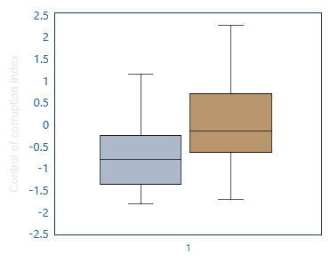
Management Natural Resources
Sovereign Wealth Funds: Size and Governance
Resource-rich countries tend to have higher perceptions of Corruption
Better
Worse
Resource-rich countries Non-resource-rich countries
Source: Natural Resource Governance Institute (2017); and Worldwide Governance Indicators.
Notes: Panel 1 shows the corporate governance and transparency score of the sovereign wealth funds and the size of assets as a percentage of 2016 GDP. Caution is needed in interpreting scores for any individual country as the quality of underlying data can vary across countries and data sources. In panel 2, the boxes show the median as well as the 25th and 75th percentiles, while the whiskers show the bottom and top 5 percent of the data.
Notes:
Extractive industries stand out as a hotspot of potential corruption.
This reflects the large profits associated with oil and mining exploration. Moreover, because these government revenues come from export receipts and multinationals and do not involve taxing citizens, there is a tendency for less scrutiny and accountability.
A study by Andersen and others (2017) finds that petroleum windfalls translate into significant increases in wealth hidden abroad by residents of some oil-rich countries.
The governance challenges of commodity-rich countries, that is, the management of public assets, call for ensuring a high degree of transparency and accountability in the exploration of such resources. Countries should develop frameworks that limit discretion, given the high risk of abuse, and allow for heavy scrutiny.
For example, Mexico adopted high transparency standards to recover public trust in the management of the oil sector. At the international level, the Extractive Industries Transparency Initiative (EITI) has promoted new disclosure standards—both within countries and for foreign companies operating in the sector in a country—and monitors countries’ abidance. Some progress has been made, but only a few countries follow most EITI recommendations.
The sheer size of economic rents associated with natural resources demands especially strong institutional safeguards. It is then critical to develop a strong institutional framework to manage these resources—including good management of the financial assets kept in sovereign wealth funds—and to ensure that proceeds are appropriately spent. This remains a significant challenge in many resource-rich countries that, on average, have weaker institutions and higher corruption.

Slide 18
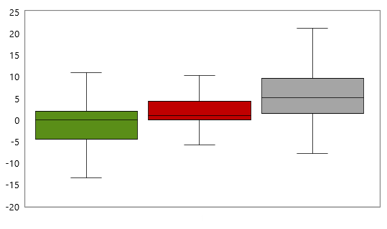
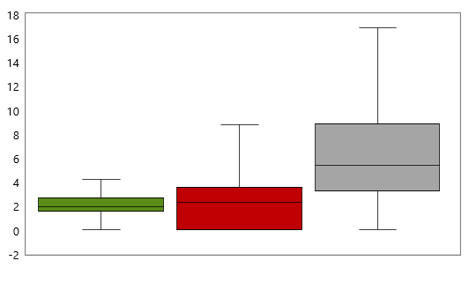
State-Owned Enterprises and Corruption
The lower corruption, the more efficient
The lower corruption, the higher profitability
Efficiency (operating revenue per cost of employee)
Profitability (ROE)
High corruption Medium corruption Low corruption
High corruption Medium corruption Low corruption
Source: Author’s estimates, Orbis, Worldwide Governance Indicators.
Notes: The charts show performance indicators for SOEs in the electricity, mining, transport and water sectors. The database includes 1,446 firms in 38 countries. The boxes show the median as well as the 25th and 75th percentiles, while the whiskers show the maximum and minimum values.
Notes:
Another hotspot for corruption is SOEs.
Governance weaknesses in SOEs can occur due to:
oversight board not being independent, leading to political influence and favoritism
poorly managed conflicts of interest resulting from close ties between SOE senior management and politicians
lack of transparency and accountability mechanisms, including absence of adequate monitoring
The evidence confirms that corruption is one of the main challenges faced by SOEs:
A survey from OECD show that almost half of companies reported corrupt acts.
In addition, the evidence suggests that 80 percent of foreign bribes go to SOE officials (OECD 2014).
Cross-country evidence, based on a large SOE dataset covering 38 countries, suggests that SOEs’ performance (profitability and efficiency) is weaker in countries with high levels of corruption

Slide 19
Fiscal Costs: Corruption affects core policies
Public Spending on Education and Health (2016)
Source: IMF, Governance Finance Statistics; and IMF staff estimates.
Notes:
But corruption does not affect only the collection of revenues, it also impacts policy decisions.
At the budget formulation stage, spending choices can be diverted to projects or activities that offer greater opportunities for kickbacks or spending that is exempt from some controls. Examples include spending on large investment projects or complex defense equipment for which there are limited price comparators.
By comparison, in the areas of education and healthcare, it is relatively more difficult for policymakers to levy bribes (Mauro 1998). Indeed, corruption is associated with fewer resources allocated to education or health spending, especially for low-income and emerging market economies.

Slide 20
Fiscal Costs: Corruption affects quality of public spending
More waste in public investment
Lower test scores
Source: Worldwide Governance Indicators, Patrinos and Angrist (2018), World Economic Outlook, and staff estimates.
Note: Public investment efficiency is estimated using efficiency frontier analysis and measures inefficiency as the distance to the frontier—maximum level of output for given levels of inputs. The output is measured by a physical indicator on the volume of economic infrastructure and social infrastructure. Inputs include capital stock and income. Harmonized test scores across samples. GDP per capita adjusted data.
Notes:
It also impacts policy implementation.
Our analysis shows that countries with lower levels of perceived corruption have significantly less waste in public investment projects. This reflects waste related to corrupt acts, such as cost overruns due to kickbacks or bid rigging in public procurement.
The evidence suggests, for instance, that an emerging market economy in the top 25 percent of the control of corruption scale wastes half as much as does one in the bottom 25 percent (most corrupt).
We see similar evidence related to the quality of education, measured by test scores.

Slide 21
The Role of Fiscal Institutions Country cases
Georgia. Total Tax Revenues
(Percent of GDP)
Rwanda. Total Tax Revenues
(Percent of GDP)
Source: Country authorities, World Economic Outlook, and IMF staff estimates.
Other cases: Estonia, Chile, and Liberia
Notes:
We start by looking at cases where countries have been able to make significant improvements over the last two decades or sustain levels of governance better that what their income-peers.
Georgia and Rwanda are the two countries displaying the largest improvements in the control of corruption index since 1996.
The fight against corruption resulted in immediate improvements in tax revenues.
How?
They undertook significant reforms across the board. It included a successful anti-corruption campaign.
Strengthening fiscal institutions has been an integral part of the anti-corruption reforms.
In both cases there were major civil service reforms.
In Georgia the tax code was simplified, including by eliminating many exemptions and reducing the number of taxes and tax rates. Rwanda undertook tax administration reforms.
Estonia, Chile, and Liberia.

Slide 22
The Role of Fiscal Institutions Georgia and Rwanda
Political will to tackle corruption
Comprehensive Institutional Reforms
Tax policy and administration
Public financial management
Civil service reform
Simplification of regulations and procedures
Digitalization
Audit institutions
Transparency
Legal framework
Notes:
I will go a bit in more detail for Georgian and Rwanda:
Decisive actions:
Significant restructuring of civil service
High-profile prosecutions
Example of Georgia: To signal their commitment, the authorities resorted to some drastic measures, such as the wholesale dismissal of the entire traffic police force and well-publicized arrests of officials suspected of corruption, including cabinet ministers and heads of state-owned enterprises.
Example of Rwanda: Several politicians and civil servants were prosecuted, when allegations of corruption were brought against them, leading to high ranking officials being forced to resigned or dismissed.
Tax reform in Georgia: In 2005, the tax code was simplified, exemptions largely eliminated, the number of taxes reduced from 21 to 7, and tax rates lowered while the tax base was widened. Similarly, in 2007 the number of import tariff rates was reduced from 16 to 3.
Revenue-administration reform in Georgia: Procedures for filing taxes were streamlined, and in 2007 an e-filing system was introduced, replacing the practice of filing taxes in person at various offices.
PFM reform in Rwanda: Started in the 2000s, comprehensive PFM reforms were designed to improve planning and budgeting, resource mobilization, budget execution and expenditure control, reporting and accountability, audit and legislative oversight arrangements. This resulted in the enactment of an Organic Law on State Finance and property regulating the implementation of budgets of central and local governments and other public entities that receive funding from the national budget in 2013.
Civil service reform:
Qualified civil servants, merit-based hiring and promotions
Requires adequate pay
Fiscal sustainability requires downsizing
- Anti-corruption measures (e.g., asset declarations)
Example of Georgia: Public employment was reduced while significantly raising remuneration, and enforcing a policy of zero tolerance for corruption. Civil service reforms established competitive and merit-based recruitment and introduced mandatory asset declarations.
Example of Rwanda: Since 1997, the government has implemented far reaching public sector reforms, including rapid downsizing with the dismissal of inadequately qualified employees and elimination of ghost workers. Salaries were increased, while new public service laws have been enacted. Since 2005, there has been greater focus on pay reform, improved human resource management as well as training and capacity building. Recruitments are increasingly done on the basis of competitive tests, following objective criteria, and institutions have internal and external audit systems. Asset declaration for politicians and civil servants in Rwanda was adopted by the 2003 constitution, requiring public officials to declare their wealth.
Simplification
Tax reform (see Georgia)
One-stop shops—example of Georgia: One-stop windows were introduced for procedures such as registering businesses and clearing customs.
Digitalization
See e-filing in Georgia
E-procurement in Georgia: The e-procurement system, introduced in 2011 and broadly consistent with good practice, has made the system more transparent and less discriminatory (World Bank, 2015). More than three-quarters of capital projects are procured competitively using the e-procurement system, and the value of direct contracting was halved from 48.7 percent of the value of all procurements in 2013 to 24 percent in 2017 (IMF, 2018).
- E-procurement in Rwanda: •Rwanda was the one of the first SSA country to implement an electronic procurement system, starting with a pilot in 2016, to minimize potential collusions among bidders and improve transparency in procurement procedures. The system consists of an online portal with modules for advertisement, e-bidding and disposal, evaluation, contract management, inspection and acceptance, framework agreements, catalog and shopping mall, where suppliers can register and submit bids online.
Audit institutions
- Example of Rwanda: Independent institutions have been established or strengthened, including the Office of the Ombudsman, the Rwanda Public Procurement Authority (RPPA), the Office of the Auditor General and the Anti-Corruption Unit.
Transparency
Georgia: Georgia also improved fiscal transparency, ranking 5th in the 2017 Open Budget Index.
Legal framework
Rwanda: A law enacted in 2003 addressed prevention and repression of corruption and related offences and other laws included commitments to fight against corruption, particularly the penal code.
Rwanda: Started in the 2000s, comprehensive PFM reforms were designed to improve planning and budgeting, resource mobilization, budget execution and expenditure control, reporting and accountability, audit and legislative oversight arrangements. This resulted in the enactment of an Organic Law on State Finance and property regulating the implementation of budgets of central and local governments and other public entities that receive funding from the national budget in 2013.

Slide 23
The Role of Fiscal Institutions Lessons from micro studies
Institutional design, supported by technology, can create the right incentives
Wages can help, but not by themselves
Monitoring and credible sanctions needed to contain corruption
Transparency particularly effective when supported by free media and civil society participation.
Notes:
To complement the country cases, we also look at micro studies. These allow to assess the impact of specific policies. Some findings emerge:
Institutional design, supported by technology, can create the right incentives. Studies on public procurement show that that the design of the procedures can have significant impact on prices and quality of products. Some reforms in India show the benefits of digitalization and reducing opportunities for discretion and fraud.
The cross-country data provides tentative support that higher wages may help reduce corruption. Country experiences show mixed results, depending on the overall environment and incentives.
Monitoring and credible sanctions needed to contain corruption. The evidence from policy experiments shows that deterrence approaches improve tax compliance. Several studies in Brazil show that increased audit risk tends to deter future corruption in subnational governments.
Transparency is particularly effective when supported by the media and civil society. For example, in Brazil, the results of audits of municipalities have a significant impact on re-election of officials suspected of misuse of public money, but these impacts were larger in areas with local radio stations.

Slide 24
The Role of Fiscal Institutions Cross-country evidence
Corruption and Institutions
More robust
Note: Coefficients are only shown if significant at the 5% level. Series are standardized.
CG - Central Government. PFM - Public financial management. Revenue institutions is an average of limits to discretionary power (RA-FIT), use of third party information (RA-FIT), and the inverted time for tax audit completion (Doing Business).
Notes:
The country cases and micro studies suggest that fiscal institutions can play a role in preventing and containing corruption. To assess whether these results hold more broadly, we now turn to systematic analysis for a larger sample of countries.
The analysis explores whether these institutional measures are associated with indicators of corruption perceptions
The analysis, one-by-one, of individual institutions shows that they are significantly associated with control of corruption. Results are particularly robust for tax complexity as well as other aspects of revenue administration.
Fiscal transparency and a lower administrative burden also correlate with lower corruption.
The analysis, when assessing the impact of institutions together, suggests that fiscal transparency is particularly effective when there is more press freedom.

Slide 25
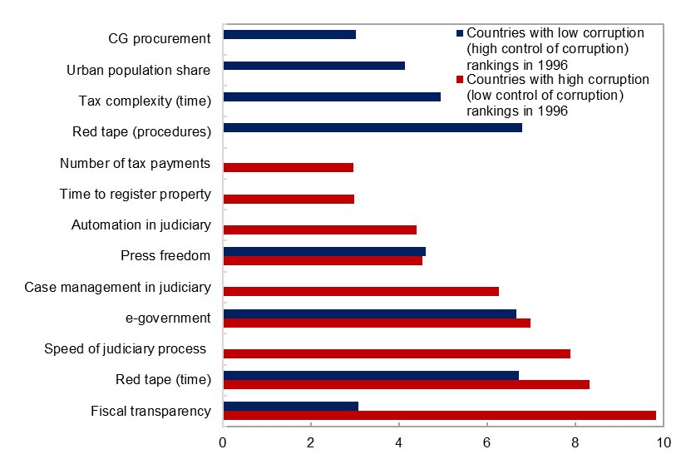
The Role of Fiscal Institutions Interactions
Relative importance of fiscal institutions
Interactions:
Transparency and press freedom
Revenue institutions can compensate for tax complexity
Judicial institutions enhance fiscal institutions (PFM, red tape)
Importance of fiscal institutions depends on past levels of corruption
Source: IMF staff estimates.
Note: Based on regression trees. The results show the top most relevant institutions out of more than 50 variables.
Notes:
The previous analysis assumed that effect of individual institutions is independent of other characteristics. This is likely to not be the case… we provide additional evidence of interactions among different institutions. We look at interaction terms, thresholds, and regression trees…
For example, a regression tree approach, which allows for such interactions, indicates that the relevance of individual institutions depends on the history of controlling corruption.
For countries that already have a tradition of low corruption, the most relevant fiscal institutions are related to degree of digitalization, administrative burden, procurement, and complexity of the tax system.
For countries that start with a high level of corruption, fiscal transparency, red tape, and digitalization stand out as key institutional features.

Slide 26
Fiscal Institutions: Promoting Integrity and Accountability
Appropriate Legal and Regulatory Framework
e.g. reduce complexity of tax laws; simplify regulations
Professional, merit-based, and ethical civil service
e.g. set right tone at the top; manage conflict of interests
Integrity of Fiscal Processes and effective Internal Controls
e.g. budget systems; procurement; tax administration
Fiscal Transparency and External and Independent Scrutiny
Continuous improvement of fiscal institutions; keep pace with technological advances (Digitalization)
Notes:
What are the lessons? The Fiscal Monitor presents the core elements of fiscal institution that can help promote governance.
Developing strong institutions that ensure integrity and a high degree of accountability has proven to be a challenge for many countries, both developed and developing countries. It requires strong and sustained political will.
Let me touch on a few examples:
On Public procurement – system of red flags to detect institutional weaknesses and risks (EU); e-procurement systems can also help to increase transparency and competition – and ultimately fight corruption with the appropriate design (good examples are Korea, Chile)
Invest in High standards of Transparency
Transparency laws (including FRLs); Use of technology (some Latin American countries use technology to show implementation of all investment projects in the web in real time).
Internal and external controls
Ongoing agenda in many countries, including advanced economies: reform internal controls (US)
Independence and capacity of external auditors (EMs, LICs)
This is a continuous work: need to adapt to ever changing corruption

Slide 27
A Global Challenge
Purpose of Foreign Bribes
Corruption as a global challenge (“Supply side”)
Multinational companies
Opaque offshore financial centers
Coordinated action can help
Prosecuting firms that bribe foreign officials
Anti-Money Laundering
Exchange of information
Dissemination of best practices, codes by IFIs
Source: OECD (2014).
Notes:
It is also to note that Corruption is a global challenge: multinational companies offer bribes to facilitate their business abroad—mostly are related to fiscal area (procurement); likewise, opacity in tax havens or offshore centers enable corruption.
International cooperation is an increasingly important element in anti-corruption efforts and building stronger institutions. More countries are making it an offense for firms to pay bribes to get business abroad. However, enforcement by individual countries has been uneven—about half of the signatories of the OECD-anti-bribery convention have not prosecuted any case...
Other initiatives include anti-money laundering and exchange of information to fight tax evasion…
International institutions and aid donors can also play a role.

Slide 28
Concluding remarks
Curbing corruption can bring large benefits
Invest in Good Fiscal Institutions
essential for Integrity and Accountability
Strengthen International Cooperation to fight corruption
Notes:
To conclude
Corruption has large fiscal costs in terms of loss revenues, waste in spending, and undermining policies.
Political will is key to fight corruption. However, to achieve sustained gains governments should invest in developing strong fiscal institutions.
Corruption is also a global problem demanding global cooperation.

Slide 29
Thank you

