Slide 1
Is the African Continental Free Trade Area a Game Changer for the Continent?
International Monetary Fund
Patrick Imam
IMF Resident Representative
June 2019
The views expressed do not necessarily reflect the views of the IMF or the Executive Board of the IMF.

Slide 2
What is the AfCFTA?

Slide 3
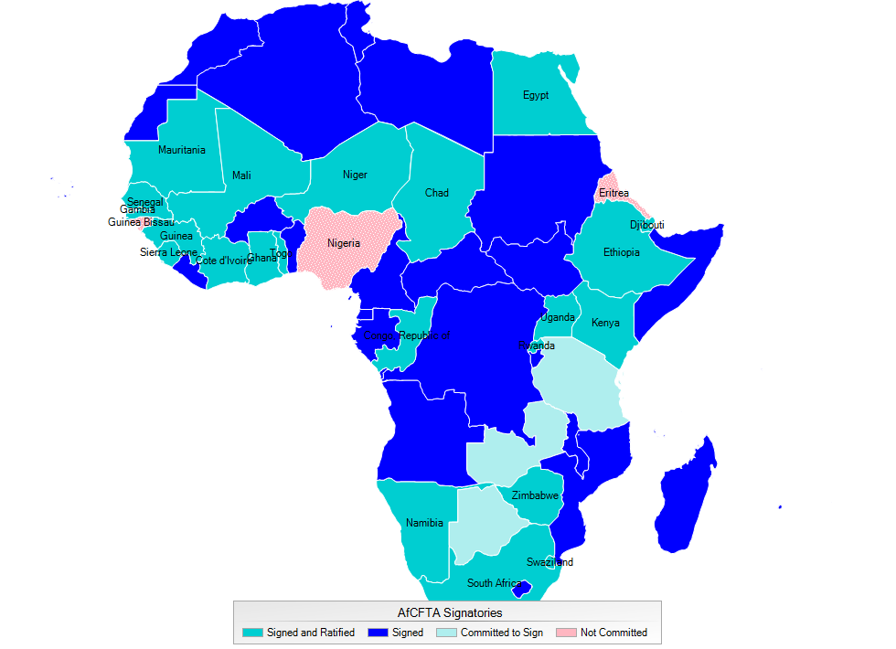
A Large Free Trade Area for the Continent
A free trade area of 55 countries, 1.2 billion people with a combined GDP of US$2.5 trillion
A ratified agreements with some key tools yet to be finalized:
  Tariff reductions on 90 percent of tradable items
  Services trade liberalization
  Clear rules of origin
  Identification of non-tariff barriers
At a later stage: free movement of labor, capital and ultimately a currency union
Notes:
As of April 2019, 22 ratifications were completed and sufficient for the AfCFTA to take effect. The most notable recent ratifications are Ethiopia and Egypt (the first non-SSA to ratify)
The AfCFTA envisages agreement on specific tariff reductions, liberalization procedures for trade of services and rules of origin during 2019. Negotiations are ongoing. In addition, countries envision a second round of negotiations to start in 2020 on intellectual property rights and competition policy

Slide 4
African Regional Trade in Perspective

Slide 5
The AfCFTA will boost intra-African trade…
African Regional Economic Communities
Tariff Rates by Regional Economic Community
Sources: United Nations COMTRADE database; and IMF staff calculations.
Recent Developments and Outlook
Challenges
Macro Policies
Managing the Impact of Conflict
Boosting Intra-Regional Trade

Slide 6
Regional Trade Integration Comparable to Other Developing Regions…
Intraregional Trade in Selected Regions, 2007–17
(Average share of total imports originating from the region)
Sources: United Nations COMTRADE database; and IMF staff calculations.
Note: ASEAN = Association of Southeast Asian Nations; LAIA = Latin American Integration Association; NAFTA = North American Free Trade Agreement; PAFTA = Pan-Arab Free Trade Area.
Notes:
Intraregional trade in goods in Africa represents about 12-14 percent of total imports.
As a share of total African imports, intraregional trade rose from approximately 5 percent in 1990 to about 12 percent in 2017.
These statistics underestimate actual intraregional trade flows though, as they do not capture widespread informal cross-border trade.
The share of intraregional trade is surpassed only by trade with China and the EU, as if Africa is the third largest trade partner.
About 40 percent of regional trade is in manufactured goods.
Africa’s trade in service also rose but plays a relatively small role in trade. Total imports (and exports) of services more than tripled from US$27 billion (US$20 billion) in 1990 to about US$90 billion (US$89 billion) in 2017

Slide 7
…and More Diversified than Africa’s Trade with the Rest of the World
Notes:
Trade with the rest of the world is heavily oriented toward minerals, which on average account (e.g., crude oil, copper), for about 75 percent of total exports during 2007–17, compared to 16 percent for manufactured goods.
- Intraregional exports include higher-value-added products, with manufactured goods accounting, on average, for about 40 percent of intraregional trade (e.g., trucks, motor vehicles), minerals for 44 percent (e.g., copper), and agricultural products for 16 percent (e.g., maize), over the same period

Slide 8
Concentrated and with Some Large Economies Poorly Integrated
Trade Integration, 2015
Sources: United Nations COMTRADE database; and IMF, World Economic Outlook database
Note: Countries ranked from largest to smallest GDP, excluding South Africa (appearing as a residual). For each country, trade share is the average of exports and imports as a share of total African regional trade. Relative regional trade integration defined as the ratio of the share of regional trade over the share of regional GDP. See page vi for country abbreviations table.
=> Potential for further expansion in regional trade
Notes:
As regional trade has expanded, sub-regional trade hubs have emerged, including South Africa, Côte d’Ivoire, Senegal, and Kenya.
South Africa alone is the source of about 35 percent of all intraregional imports in Africa (and about 40 percent of intraregional manufacturing imports).
However, as shown in the chart, some of the largest African economies remain poorly integrated with the region. Nigeria, Egypt, and Algeria, which collectively represent about half of the region’s total GDP, account for a limited share of regional trade (about 11 percent).
This suggests ample room for further expansion

Slide 9
Near-Zero Tariffs in RECs and Substantial Non-Tariff Bottlenecks
Africa: Average Tariff Rates by Regional Economic Community, 2010–17
Nontariff Trade Costs, 2015
(Tariff equivalent)
Sources: UNCTAD Trade Analysis Information System; and IMF staff estimates.
Source: ESCAP - World Bank Trade Cost database.
=> Tariffs matter but other factors affect regional trade flows
Notes:
The expansion of regional trade flows within Africa in recent decades occurred along with the creation and expansion of several RECs, which apply near-zero preferential tariffs to trade within the RECs
In 2017, 75 percent of intraregional trade took place in five RECs, with Southern Africa Development Community (SADC) alone accounting for half of such trade flows
Tariffs are virtually zero within RECs, while tariff applied to other African countries are similar to the rest of the world
Moreover, factors other than tariffs make transacting goods particularly costly for African countries (see right figure). In this respect, African countries have among the highest non-tariff trade costs in the world. (note: factors may include trade facilitation services, ranging from logistics and transport infrastructure to border processes and customs practices and business and regulatory environments.

Slide 10
Potential Impact of The AfCFTA on Trade

Slide 11
Some room for further regional trade integration

Slide 12
Structural and Policy-Induced Factors Imply Low Levels of Trade In Africa
Role of Country Features in Affecting Regions' Trade Flows
(Median and interquartile range of country fixed effects from the gravity model)
Source: IMF staff estimates.
Notes:
Estimates from gravity model suggest that African countries are, on average, expected to trade less than countries in other regions.
In other words, specific features of African economies, besides size and level of development, imply low levels of trade compared to other regions. These features include structural factors to African economies, and policy-induced factors such as tariffs, poor quality of logistics and infrastructure, and limited availability of credit.
Note: the chapter relies on a gravity model, using COMTRADE bilateral goods data at the 1-digit industry level in 200-2015, the database covers 148 countries, yielding almost 900,000 observations. Importer-industry-time and exporter-industry-time fixed effects are used, as well as distance, contiguous border, common language, colonial history, and the presence of a preferential trade agreement variables.

Slide 13
Addressing non-tariff bottlenecks key to deepen regional trade integration

Slide 14
Tariff Reductions Increase Regional Trade, but Non-Tariff Bottlenecks Matter Even More
Elasticity of Intraregional Trade
(Tariff equivalent)
Sources: UNCTAD Trade Analysis Information System; and IMF staff estimates.
Notes:
Empirical analysis for African countries shows that
Tariff reductions may boost intraregional trade in the region While An extensive reduction in tariffs, as planned under the AfCFTA, may have sizable effect on trade flows : eliminating tariffs on 90 percent of currently taxed intraregional trade flows would increase intraregional trade by about US$16 billion or about 16 percent from recent.
However, better logistics and infrastructure could be even more effective (greater normalized elasticity) in boosting trade than tariffs. Other factors like easier access to credit and a more supportive business environment, are also associated with higher intraregional trade flows.
Provide some idea of magnitude:
Trade logistics is one of the most important impediments to intraregional trade. Bringing the quality of logistics to the global average level (an improvement of about 19 percent) would lower the cost of cross-border movement of goods and increase intraregional trade by over 12 percent.
For infrastructure, the effect is a more limited and ringing the quality of infrastructure to the global average (an improvement in infrastructure quality of about 40 percent) would spur a 7 percent increase in intraregional trade flows.
Note: Looking at logistics, customs-related services—including clearance procedures, and to some extent, activities of typically regulated sectors such as brokerage services— are particularly important average levels

Slide 15
Poor Infrastructure and Logistics Affect the Impact of Tariff Reductions on Trade
Infrastructure and Trade Logistics Gaps in Africa
Notes:
Tariff reductions have smaller effects on trade if the quality of infrastructure is below a minimal threshold
This effect is particularly strong in landlocked countries
In these countries, logistical services have a greater effect on trade than in other countries and basic services enhance the impact of tariff reductions greatly
Note: Estimate panel regression models – 124 countries covering period 1990-2017 – fixed effects – all variables are in logs

Slide 16
Larger Welfare Payoffs From Reducing Non-Tariff Bottlenecks
Main results from CGE models
With tariff reductions, intra-African trade increases, but limited welfare and growth effects
Reducing NTBs/trade costs improves welfare effects substantially
Results vary greatly across countries. Very few countries worse off in absolute levels.

Slide 17
The AfCFTA Can Affect Countries Unevenly

Slide 18
Structural reforms can help strengthening the impact of the AfCFTA on trade

Slide 19
Combining Trade and Structural Policies Increases Payoffs for Less Diversified Economies
Additional GDP Impact of Trade Expansion under Structural Reform Scenarios, Agricultural Exporter
(Percent)
Source: IMF staff estimates.
Note: Trade expansion is defined as the increase in openness (exports plus imports to GDP). "Limited reform scenario" implies a 3 percent additional long-term effect on GDP levels, while "comprehensive reform scenario" implies a 7 percent additional increase in GDP.
Notes:
- CGE models show that smaller countries, more diversified and manufacturing-oriented economies, and existing trade hubs are likely to benefit more from regional trade integration than more agriculture-oriented and natural-resource-exporting economies.
- Using a DSGE model, the chapter shows that complementary structural reforms that boost efficiency in those sectors where developing countries have competitive advantages (for example, agriculture) may amplify the positive effect of deeper trade and increase GDP by 15-30 percenrt more than trade alone could do.

Slide 20
limited effects on income distribution in Africa

Slide 21
Trade Integration Unlikely to Increase Inequality in the Medium Term
Higher income inequality in the short term
But, the inequality-increasing effect fades away over the medium term
Informality increases inequality but appears to reduce the effects of trade liberalization on inequality
Impact on African economies not substantially different from other countries.
Notes:
Panel regression: 114-124 countries (advanced and developing, 27-32 African), 2000-14.

Slide 22
Small reductions in fiscal revenue with exceptions in some countries

Slide 23
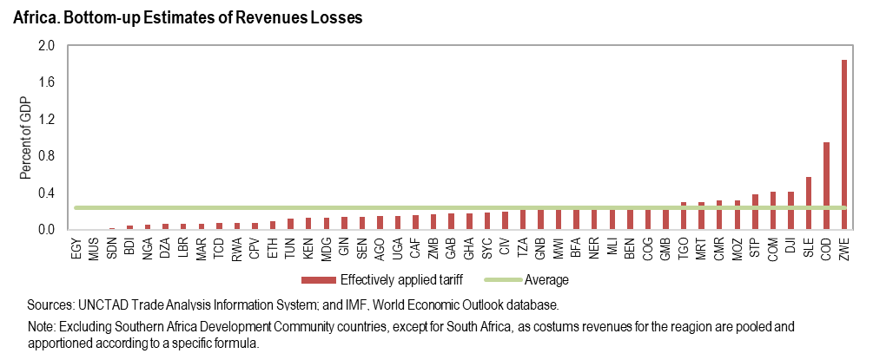
Limited Revenue Losses, with Few Exceptions
Notes:
Overall customs revenues in Africa are relatively low and only a small portion of such revenue depends on regional trade. Over 2010–15, customs revenue averaged about 2.5 percent of GDP (16 percent of total tax revenue) and overall regional imports, including zero-rated imports within RECs, averaged about 17 percent of total imports.
The picture was radically different only two decades ago before many African countries joined the World Trade Organization (WTO) and signed several trade agreements
The chapter applies the effectively applied average tariff rate to countries’ import data by individual product. Assuming the elimination of all tariffs on intraregional imports, and accounting for VAT losses due to smaller tax bases, the average estimated revenue loss is low at about 0.3 percent of GDP.
However, revenue losses in some countries could be large, exceeding 1 to 2 percent of GDP (e.g., Zimbabwe, Democratic Republic of Congo, Sierra Leone). This represents an upper bound for possible revenue losses as the AfCFTA requires eliminating tariffs on only 90 percent of trade items.
Using growth and trade diversion elasticities to tariffs from the literature, the analysis also shows that the dynamic effects from trade diversion and GDP growth from tariff reduction may lead to larger, although still limited, revenue losses.
On average, the revenue loss would amount to about 0.5–0.8 percent of GDP, depending on the assumed elasticities. However, in a few countries revenue losses may be as large as 3-5 percent of GDP (e.g., Zimbabwe, Zambia).

Slide 24
Messages

Slide 25
Zimbabwe’s trade: Africa and the World

Slide 26
Zimbabwe and the AfCFTA
Zimbabwe ratified the AfCFTA agreement in April 2019
Zimbabwe’s Industrial Development Policy expired in 2016
Trade will not be an engine of growth if underlying macro-financial constraints are not tackled:
      Fiscal adjustment leading to macro-economic stability
      Successful currency reform
For that, need to implement Transitional Stabilization Program/Staff Monitored Program

Slide 27
Zimbabwe and the AfCFTA
What Zimbabwe needs to do
Put in place effective financial and legal institutions to allow the free flow of goods and services
Improve the “doing business” indicators, and ensure that it forms and retains the right human capital
Increase the value added to its products as raw products dominate exports
Implement revenue enhancing measures and attend to inefficiencies in revenue administration as the country is expected to loose substantial revenue due to the implementation of the AfCFTA as highlighted before
Work, of course with other countries, on the operationalization of one-stop border posts, with South Africa, Zambia, Botswana and Mozambique.

Slide 28
Key Messages
Tariff reductions can play a significant role in fostering intraregional trade, if applied to a large proportion of trade…
…and should be complemented by policies to reduce non-tariff bottlenecks (e.g. logistics)
Policies should address the adjustment costs of trade integration:
  Boost agricultural productivity in less diversified economies
  In a few countries, mobilize domestic tax revenue to offset losses
  Use targeted social programs and training schemes to ease workers mobility across industries to mitigate adverse effects on income distribution

Slide 29
Thank You

