Slide 1

Recovery amid Uncertain Times
Patrick Imam
IMF Resident Representative
May 2019
The views expressed do not necessarily reflect the views of the IMF or the Executive Board of the IMF.

Slide 2
Key Messages
Economic performance in sub-Saharan Africa remains bifurcated:
    The more diversified economies (21 out of 45) continue to grow at over 5%
    But growth remains anemic in other more resource-dependent economies (home to 2/3 of the region’s population)
Should the current complex and less-supportive external environment worsen:
    Where growth remains strong, continue building buffers
    Elsewhere, calibrate policies to support growth where financing and debt considerations allow
Reforms needed to manage development spending needs and create jobs:
    Improve tax revenue collections, public financial management, and spending efficiency
    Facilitate greater private investment
    Raise productivity, including by promoting diversification and export competitiveness
    Reduce non-tariff barriers and promote intra-regional trade

Slide 3
Roadmap
    Recent Developments and Outlook
  Challenges
  Building Resilience and Raising Growth
    Zimbabwe – economic developments

Slide 4
Growth is recovering but varies considerably among countries
Real GDP Growth Distribution, 2019
Weighted average = 3
(2018)
Weighted average = 3.5
(2019)
Source: IMF World Economic Outlook database.
Recent Developments and Outlook
Challenges
Macro Policies
Managing the Impact of Conflict
Boosting Intra-Regional Trade

Slide 5
In particular, recent and prospective growth performance is split between resource- and non-resource-intensive countries
Challenges
Macro Policies
Managing the Impact of Conflict
Boosting Intra-Regional Trade
Real GDP per Capita, 1990–23
Source: IMF World Economic Outlook database.
Recent Developments and Outlook
Challenges
Macro Policies
Managing the Impact of Conflict
Boosting Intra-Regional Trade

Slide 6
Growth in resource-intensive countries was adversely impacted by the large 2014 terms-of-trade shock…
Recent Developments and Outlook
Challenges
Macro Policies
Managing the Impact of Conflict
Boosting Intra-Regional Trade
Goods Terms of Trade, 2013-23
Source: IMF World Economic Outlook database.
Recent Developments and Outlook
Challenges
Macro Policies
Managing the Impact of Conflict
Boosting Intra-Regional Trade

Slide 7
But even among the resource-intensive countries, growth outcomes remain quite diverse
Recent Developments and Outlook
Challenges
Macro Policies
Managing the Impact of Conflict
Boosting Intra-Regional Trade
Real GDP Growth Distribution, 2019
Source: IMF World Economic Outlook database.
Recent Developments and Outlook
Challenges
Macro Policies
Managing the Impact of Conflict
Boosting Intra-Regional Trade

Slide 8
The slower growth rates in some of the region’s larger economies is noteworthy
Recent Developments and Outlook
Challenges
Macro Policies
Managing the Impact of Conflict
Boosting Intra-Regional Trade
Average Real GDP Growth Distribution, 2001-10
Median = 4.1
Source: IMF World Economic Outlook database.
Recent Developments and Outlook
Challenges
Macro Policies
Managing the Impact of Conflict
Boosting Intra-Regional Trade

Slide 9
The slower growth rates in some of the region’s larger economies is noteworthy
Recent Developments and Outlook
Challenges
Macro Policies
Managing the Impact of Conflict
Boosting Intra-Regional Trade
Average Real GDP Growth Distribution, 2011-19
Median = 4.3
Source: IMF World Economic Outlook database.
Recent Developments and Outlook
Challenges
Macro Policies
Managing the Impact of Conflict
Boosting Intra-Regional Trade

Slide 10
In South Africa, lower private investment is contributing to slower growth
Recent Developments and Outlook
Challenges
Macro Policies
Managing the Impact of Conflict
Boosting Intra-Regional Trade
Private Investment and Real GDP Growth, 2000-18
Sources: Haver and IMF staff calculations.
Recent Developments and Outlook
Challenges
Macro Policies
Managing the Impact of Conflict
Boosting Intra-Regional Trade

Slide 11
In Nigeria, the sharp drop in oil prices and ongoing adjustment have slowed growth…
Recent Developments and Outlook
Challenges
Macro Policies
Managing the Impact of Conflict
Boosting Intra-Regional Trade
Real GDP Growth and Components, 2011-18
Source: NBS Nigeria, World Economic Outlook and staff projections.
Recent Developments and Outlook
Challenges
Macro Policies
Managing the Impact of Conflict
Boosting Intra-Regional Trade

Slide 12
…and much the same in Angola
Recent Developments and Outlook
Challenges
Macro Policies
Managing the Impact of Conflict
Boosting Intra-Regional Trade
Oil Price and Real GDP Growth, 2006-18
Source: IMF World Economic Outlook database.
Recent Developments and Outlook
Challenges
Macro Policies
Managing the Impact of Conflict
Boosting Intra-Regional Trade

Slide 13
Roadmap
  Recent Developments and Outlook
    Challenges
  Building Resilience and Raising Growth
    Zimbabwe – economic developments

Slide 14
The uncertainties in the external environment pose a challenge for policymakers
Volatility in Real Commodity Prices, 2011-14 and 2015–18
Volatility of EMBI Spreads, 2011-14 and 2015–18
Sources: IMF, Commodity Price System.
Sources: Bloomberg and staff calculations.
Recent Developments and Outlook
Challenges
Macro Policies
Managing the Impact of Conflict
Boosting Intra-Regional Trade

Slide 15
Volatile capital flows have been dealt with more through changes in reserves than exchange rates
Exchange Market Pressure, 2018
Sources :IMF, International Financial Statistics database; and IMF staff calculations.
Recent Developments and Outlook
Challenges
Macro Policies
Managing the Impact of Conflict
Boosting Intra-Regional Trade

Slide 16
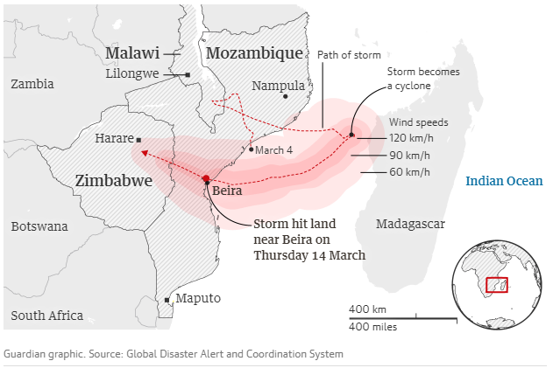
Climate shocks threaten the outlook for a number of southern African countries
Tropical Cyclone Idai
Source: Guardian graphic; Global Disaster Alert and Coordination System.
Recent Developments and Outlook
Challenges
Macro Policies
Managing the Impact of Conflict
Boosting Intra-Regional Trade

Slide 17
On current policies, the recovery beyond 2019 looks set to be marginal
Real GDP Growth, 2013-23
Source: IMF World Economic Outlook database.
Recent Developments and Outlook
Challenges
Macro Policies
Managing the Impact of Conflict
Boosting Intra-Regional Trade

Slide 18
…and would not be enough to create much needed jobs in many countries
Change in Employment, 2019-23
Sources: United Nations, International Labour Organization; and IMF staff estimates.
Recent Developments and Outlook
Challenges
Macro Policies
Managing the Impact of Conflict
Boosting Intra-Regional Trade

Slide 19
Roadmap
  Recent Developments and Outlook
  Challenges
    Building Resilience and Raising Growth
    Zimbabwe – economic developments

Slide 20
Public debt dynamics are stabilizing somewhat, albeit at higher debt levels
Public Debt
Oil exporters
Other resource-intensive countries
Non-resource-intensive countries
Source: IMF World Economic Outlook database.
Recent Developments and Outlook
Challenges
Macro Policies
Managing the Impact of Conflict
Boosting Intra-Regional Trade

Slide 21
Fiscal adjustment has helped, but more is still needed in many cases…
Change in Fiscal Deficit, 2013–17
Medium-Term Fiscal Plans, 2018–23
Lowering fiscal deficit
Source: IMF, World Economic Outlook database; and IMF staff calculations.
Recent Developments and Outlook
Challenges
Macro Policies
Managing the Impact of Conflict
Boosting Intra-Regional Trade

Slide 22
…as debt vulnerabilities are notably elevated…
Debt Risk Status, 2008–18
Source: IMF Debt Sustainability Analysis Low-Income Developing Countries database.
Recent Developments and Outlook
Challenges
Macro Policies
Managing the Impact of Conflict
Boosting Intra-Regional Trade

Slide 23
…and will remain so as concessional financing will remain scarce
New Debt Flows since 2010
$722 bn
2010
Note: Excludes Equatorial Guinea, Namibia, Seychelles, and South Sudan.
Recent Developments and Outlook
Challenges
Macro Policies
Managing the Impact of Conflict
Boosting Intra-Regional Trade

Slide 24
Roadmap
  Recent Developments and Outlook
  Challenges
  Building Resilience and Raising Growth
    Zimbabwe- Economic Developments

Slide 25
Warning
Many statistical series (e.g. nominal GDP) need to be re-estimated in the new local currency, the RTGS$ because:
    Currency reform
    Currency depreciation (official and unofficial rates)
    GDP re-basement
ZIMSTAT aims to have revised macroeconomic statistics series ready by mid-2019, but until then, a proxy for nominal GDP is required:
    A key implication of the depreciation of the RTGS$ against the USD is that nominal GDP in local currency has grown rapidly, driven by a large GDP deflator.

Slide 26
Diagnostic
Macroeconomic instability driven by:
Large fiscal deficits financed by the issuance of quasi-currency instruments
    The fiscal deficit is estimated at 7.1 percent of GDP in 2018
    Net credit to the central government by RBZ increased by $3.0 billion in 2018
The current account deficit widened in 2018 (-4.5 percent of GDP) due to a sharp increase in imports.
    fragile equilibrium is maintained by capital controls, restrictions on access to FX, and other distortions
Debt distress, with debt level of US$9.6 billion at end-2018.
Inflation has picked up in recent months, reaching 76 percent (y/y) in May 2019.

Slide 27
Zimbabwe: Parallel Market Exchange Rate

Slide 28
The financing of the deficit through printing money led to rising parallel market exchange rate…

Slide 29
…contributing to rising inflation.

Slide 30
… leading a the real effective exchange rate depreciating.

Slide 31
Transitional Stabilization Program (TSP)/Staff Monitored Program
Significant economic reforms are underway
    TSP is a stabilization and structural reform program aimed at addressing the deep macroeconomic imbalances and fostering private sector growth
The program targets:
    fiscal consolidation during 2019-20,
    reforming and privatizing state-owned enterprises,
    addressing corruption in procurement and revenue administration, and
    promoting private-sector investment by improving the ease of doing business and access to finance.
Political reforms are advancing (POSA, AIIPA)
The SMP is anchored on the policies laid out in the authorities’ TSP:
    Assist the authorities to implement and monitor the key policies outlined in their TSP
    2019 budget halts central bank financing of the budget
    The program would help Zimbabwe build a track record of sound economic policies towards normalizing relations with external creditors

Slide 32
SMP main objectives:
(i) reduce the fiscal deficit to restore macroeconomic stability, while maintaining investment in infrastructure and priority social spending;
(ii) stop monetary accommodation of the fiscal deficit to stabilize inflation and the exchange rate;
(iii) increase financial sector stability by implementing financial sector reforms and tightening the regulatory framework;
(iv) address governance and corruption vulnerabilities; and
(v) advance the structural reform agenda, including in Public Financial Management (PFM) and revenue administration, as well as State-Owned Enterprise Reform.

Slide 33
Fiscal Adjustment
The baseline is built on a revised 2019 Budget approved by Cabinet on April 23.
  Significant fiscal adjustment is needed to stabilize the economy and restore confidence (4.0 percent of GDP compared to 7.1 percent in 2018):
  Wage bill: reduced by 2½ percent of GDP by (e.g. limiting wage increases in 2019 to 18 percent in nominal terms)
  Grain subsidies: reducing expenditure by 2.3 percent of GDP in 2019 (e.g. ensuring proceeds from grain sales are returned to the budget)
  Limiting transfers to SOEs: in line with efforts to privatize or liquidate 43 parastatals and strengthen governance and accountability in 31 other SOEs. Committed to reviewing the mandate of ZAMCO and freeze additional financing for its operations.
  Revenue increases: The 2 percent tax electronic financial transactions introduced in October 2018 is projected to raise about RTGS$1.2 billion (or 1.7 percent of GDP) in 2019. Hike in fuel excise taxes in January and the planned change in mid-2019 to establish a transparent fuel price formula that is projected to increase revenue by RTGS$1 billion in 2019 relative to 2018

Slide 34
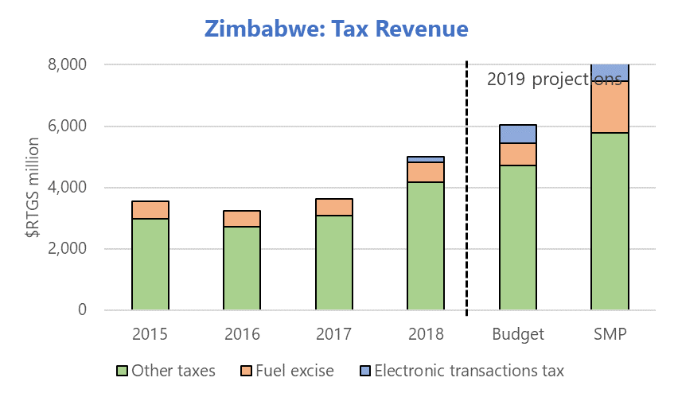
Fiscal Adjustment (Con’t)

Slide 35
Expenditure Side/Financing
Increase social spending: on education, health, and social protection programs targeted at vulnerable households (e.g. distribution of food reserves to the most vulnerable population at subsidized prices, scaling up the cash transfer program, support to rural areas affected by drought, expanding free food program in schools, and subsidies for public transportation)
Defined-contribution pension system to be introduced in 2019: cost an additional 0.6% of GDP p.a. but saving over long-run)
Earmark 5% of projected revenue (about ½ percent of GDP) to be transferred to provinces and municipalities, in line with Constitutional requirements
To protect the most vulnerable, target a minimum floor on social spending (RTGS$750 million for 2019)
The financing of the fiscal deficit in 2019 relies mainly on issuing debt instruments in the domestic market.
No new non-concessional debt allowed.

Slide 36
Macroeconomic Outlook …
The exchange rate, after a period of high volatility and overshooting, is expected to stabilize, consistent with the tight fiscal and monetary policies targeted under the program.
Real GDP growth is projected to be negative in 2019 (-2.1 percent), as the significant consolidation and the impact of the drought and the cyclone drag down economic activity. A rebound in economic activity is expected in 2020 and over the medium term, as uncertainty declines, distortions from multiple exchange rates are removed, and relations with external creditors normalize.
Monthly inflation is expected to moderate starting in mid-2019, which would help to anchor inflation expectations and nominal interest rates.

Slide 37
Medium-Term Macroeconomic Framework—Baseline
Zimbabwe: Medium-Term Macroeconomic Framework—Baseline (Reform Scenario)

Slide 38
Risks to the outlook
Risks remain tilted to the downside and include factors both within and outside the authorities’ control:
    Social and Political resistance to reform
    Policy slippages (e.g. currency reform), or interference by vested interests,
    Spending pressures, particularly on wages, social support, subsidies to SOEs and agriculture, and financial sector bailouts could jeopardize fiscal goals.
    The envisaged deep fiscal adjustment needs to be carefully implemented to avoid a too a heavy toll on vulnerable portions of the population.
Factors beyond the authorities control include:
    A worse-than-envisaged agricultural season,
    Exacerbating risks of poverty and social discontent, and
    A slow recovery in confidence that delays a resumption of economic activity, particularly in export industries like mining.
    The outlook also does not factor in a significant macroeconomic impact from Cyclone Idai, and the power cuts going forward.

Slide 39
Quantitative Targets

Slide 40
SMP Structural Benchmarks

Slide 41
Conditions for IMF financial engagement
Arrears clearance to the IFIs
Reengagement
Financing assurances from bilateral creditors
Comprehensive, consistent package of policies for sustainable, inclusive growth

Slide 42
Thank You

